Slide 1
Team Work Assignment OOP Programming, Role – Playing Game Team “ Grasshoper ”
Participants:
Петър Ненов – pepoto,
Динко Кръстев – DinkoK,
Нина Петкова – nina75,
Антонио Маринов – Nottyy,
Александър Николов = redOne,
Антоний Зюмбюлев - antonious7,
Пламен Пенчев – Burned,
Васил Профиров – V.Profirov,
Явор Михалйлов – phreak,
Николай Георгиев – niki.georgiev,
Петко Попов - PetkoP

Slide 2
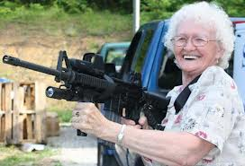
Briefly summary about the game:
Resume:
One rainy afternoon, Pesho’s recidivist grandmother has finally decided to bring order in the tense situation in Sofia and put an end the state iniquities and outrages, as walking in front of the Parliament and with bare hands starting to strike at police officers and deputies with whatever she carries in her bag and with herself. She even got far more well prepared because early before she came across the battlefield ,she found a gun in an abandoned building next to her apartment in Lulin 3.
Main characters – The Grandmother
Secondary characters:
Moving objects - Policemen, Politicians, Deputies
Non moving objects – Parliament, Gardens, BG mom, Walkers

Slide 3
Grandmother’s attributes and Scenario
Attributes:
- Bag, Cane, Umbrella, Gun, Money
Scenario:
The grandmother firstly has only cane, umbrella, bag and gun, as she doesn’t have any money.
If she kills a politician, deputy or a policeman she gains 100$.
She could visit BG mom for guns, if she has money
If she goes through a politician , deputy or a policeman, without killing it, she loses a precise part of her equipment. After losing all the available equipment she starts losing her health.
The game ends when she loses all her equipment and health.

Slide 4
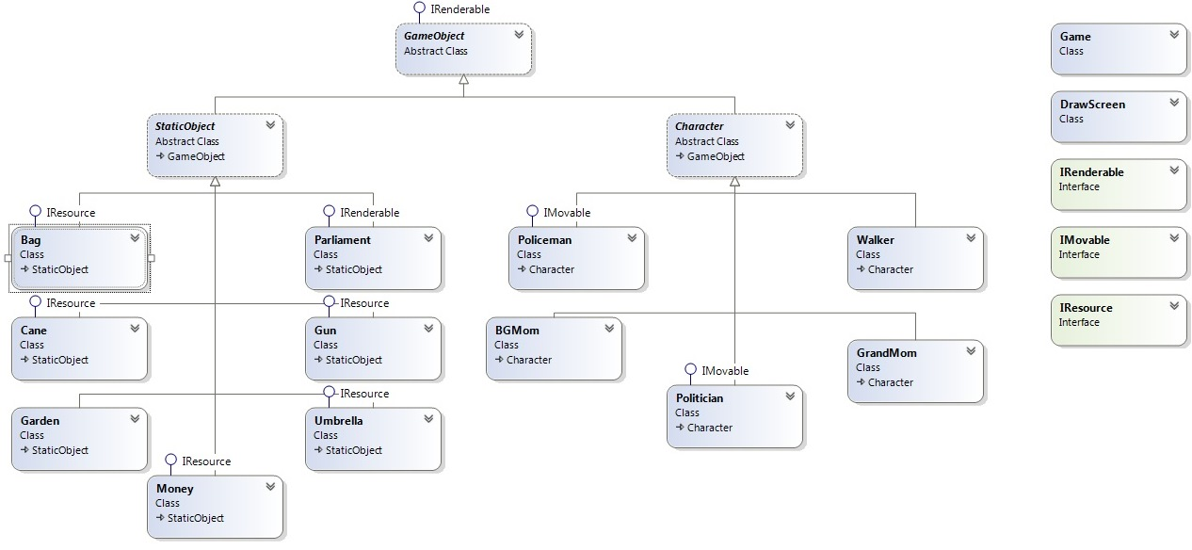
Class Diagram

Slide 5
